Slide 1






WindPlan
Vestas

Slide 2



Slide 5

Simplicity
Personalization

Slide 6
Simplicity
Personalization

Slide 7
Simplicity
Personalization

Slide 8
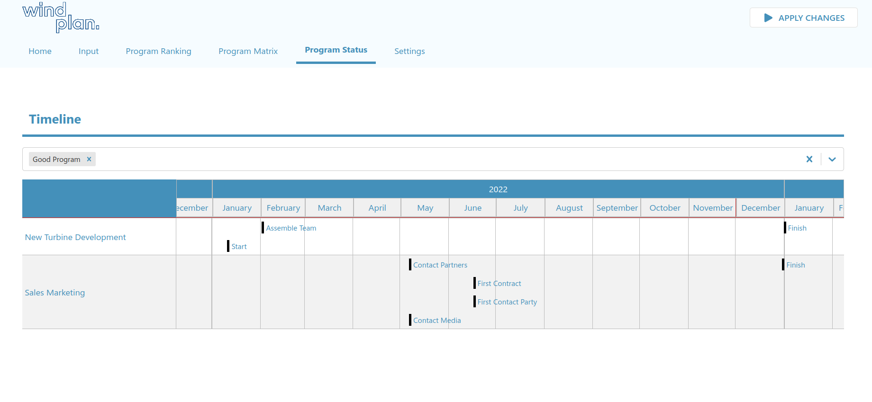
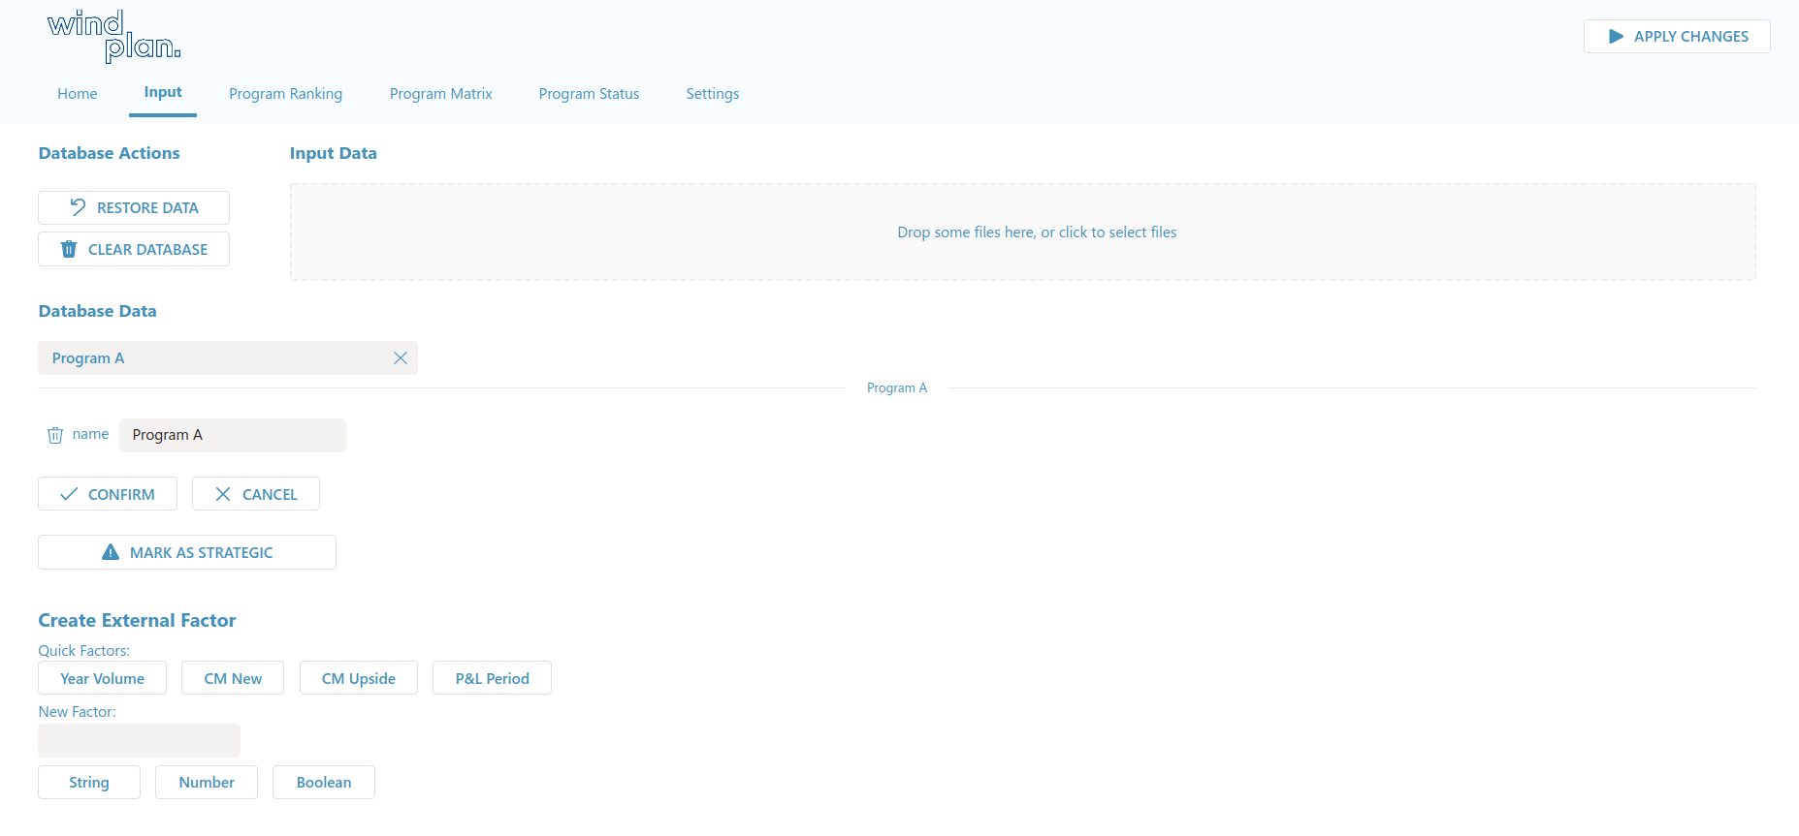
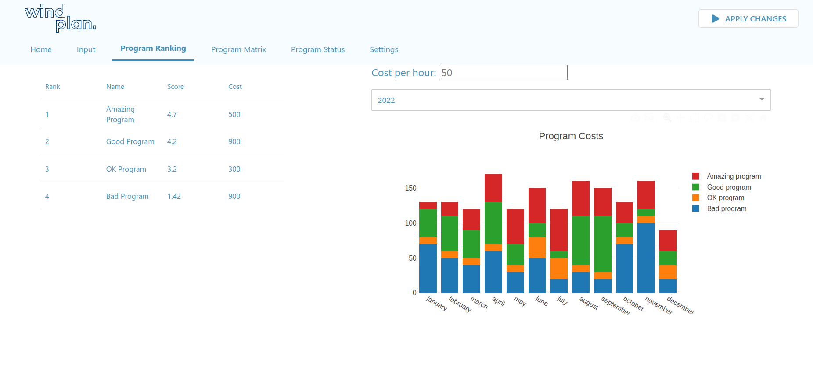

Slide 9
Lower learning time
Boost performance
Decrease costs
EMPLOYEES

Slide 10



